Slide 1
Renaissance Art
Up close with the two influential artist of the time

Slide 2
Renaissance Art
16th century art which is known as “High Renaissance” is associated with these artist…
Leonardo da Vinci
Michelangelo
These artist created such amazing works that generations of later artist relied on their artworks for instruction.

Slide 3
Leonardo da Vinci
Da Vinci’s Life
Born April 15th, 1452 Italy
He was considered the greatest Renaissance Man who ever lived.
He was a scientist, inventor, painter, sculptor, architect, mathematician, writer, musician, and anatomist.

Slide 4
Leonardo da Vinci
His Discoveries
Conceptualized …
Helicopter
Tank
Solar Power
Calculator
Outlined a rudimentary theory of plate tectonics.

Slide 5
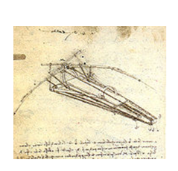
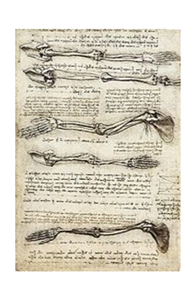
Leonardo da Vinci
Journal Entries
He kept his ideas in journals-but he used coded writing so that his theories could not be stolen.
Over 13,000 pages have been discovered so far.

Slide 6
Virgin of the Rocks
Virgin of the Rocks
This painting shows the usage of chiaroscuro
Which means the subtle play of light and dark.
Leonardo’s use of chiaroscuro created an emotional state with the viewer with his play of light and dark.

Slide 7
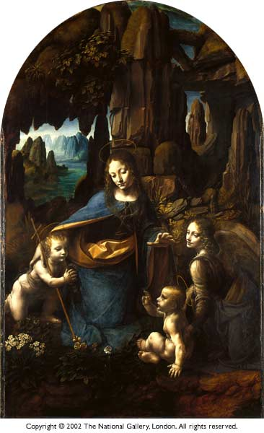
Virgin of the Rocks Cont…
Leonardo presented the figures in Virgin of the Rocks in a pyramidal grouping.
Leonardo’s use of atmospheric perspective is in full view in this painting.
The figures pray, point, and bless in a circular fashion. Doing this creates a visual unity throughout the painting.

Slide 8
The Last Supper
Created by Leonardo during the time of 1495-1498.
This is a great example of perspective being used in a composition.
See how all the lines converge to a central point above Christ’s head.

Slide 9
Leonardo da Vinci
Interior view of the Convent St. Maria delle Grazie in Italy.
This is a fresco created on the wall.

Slide 10
Mona Lisa
Created by Leonardo da Vinci during 1503-1505
This is probably the world’s most famous portrait.
The woman in this portrait is still to this day unknown.

Slide 11
Mona Lisa
Her famous smile is really created by the use of chiaroscuro and atmospheric perspective.
Leonardo slightly adjusted the light and blurred the background.
Leonardo’s famous smokey sfumato (misty haziness) makes her facial expressions hard to determine also.

Slide 12
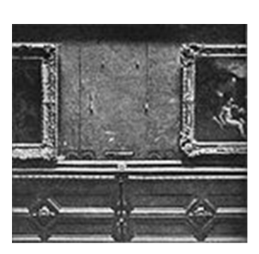
Leonardo da Vinci
The Mona Lisa was stolen from the Louvre on August 21st 1911 by Italian Vincenzo Peruggia.

Slide 13
Michelangelo
Michelangelo was best know for his work in sculptures and his work on the Sistine Chapel.
Michelangelo was different from the sculptors before him, he felt that sculptors who sculpt for perfection in form were wrong.
Michelangelo started the art of self expression.
Creating art with intent and not just by measure. (Made sculptures to look like actual people)

Slide 14
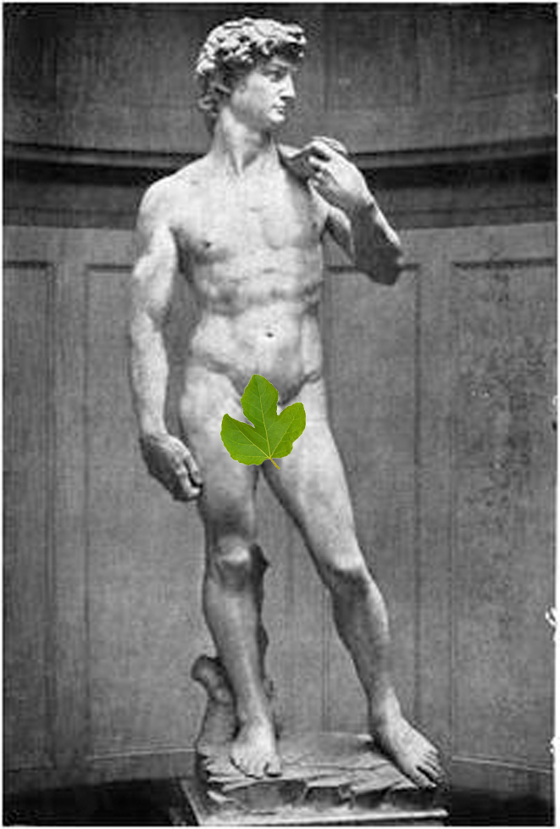
David
Created by Michelangelo during 1501-1504.
Michelangelo was asked to work on a great block of marble left from an earlier commission.
From this stone Michelangelo created David.

Slide 15
David Cont…
Despite how most people usually depicted David with heroism, Michelangelo chose to depict David not after the victory with Goliath’s head at his feet but with his head turned to the left, sternly, watchful of the approaching foe.
This exhibits the representation of energy and tension in the sculpture.

Slide 16
The Sistine Chapel

Slide 17
Sistine Chapel Cont…
Created by Michelangelo during the span of 4yrs. (1508-1512)
At first Michelangelo did not want to paint the Sistine Chapel.
He had only done sculptures up until this time.

Slide 18
Sistine Chapel Cont…
Michelangelo faced enormous difficulties in painting the Sistine ceiling.
Had never done a fresco before
The ceiling’s dimensions
Some 5,800 square feet
Height above the pavement
Almost 70 feet
Perspective problems with painting with the ceilings curve.

Slide 19
Sistine Chapel Cont…
Even with all those challenges within 4 years Michelangelo created this monumental fresco within the Sistine Chapel.

Slide 20
Other Artist during the Renaissance
There are many other great artist throughout the Renaissance period.
To name a few
Titian
Caravaggio
Giovanni Bellini
Bernini

